Slide 1

Swarm Robotics based Multi-Agent Coordination System
CSA1709-Artificial Intelligence
Presented by:
P.Ramesh (192312443)
AVULA Adarsh (192365002)
Guided By:
Dr Rajaram P

Slide 2


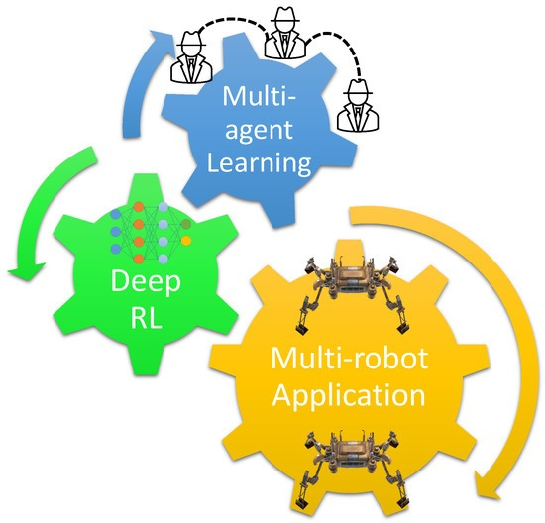
INTRODUCTION
Swarm Robotics is a technology in which multiple robots work together to perform a common task.
Each robot acts as an independent agent and communicates with other robots.
The system is inspired by the collective behaviour of ants, bees, and birds.
Multi-agent coordination allows robots to share information, divide tasks, and make decisions collectively.

Slide 3
OBJECTIVES
To develop a system where multiple robots work together to complete a common task.
To enable communication and information sharing between robots.
To implement efficient task allocation and coordination among multiple agents.
To achieve collision-free movement and obstacle avoidance.
To improve area coverage and task completion time.
To enable robots to make distributed and autonomous decisions.

Slide 4
PROBLLEM STATEMENT
Develop a Swarm Robotics based Multi-Agent Coordination System.
Enable multiple robots to work together autonomously.
Provide robot-to-robot communication for sharing information.
Implement efficient task allocation among robots.
Enable collision and obstacle avoidance.
Support real-time decision-making in dynamic environments.
Improve area coverage and task completion efficiency.

Slide 5
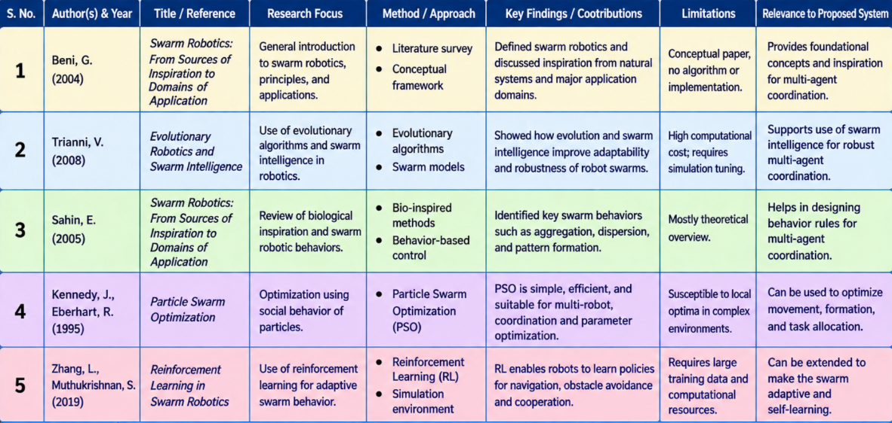
Literature Review Background

Slide 6
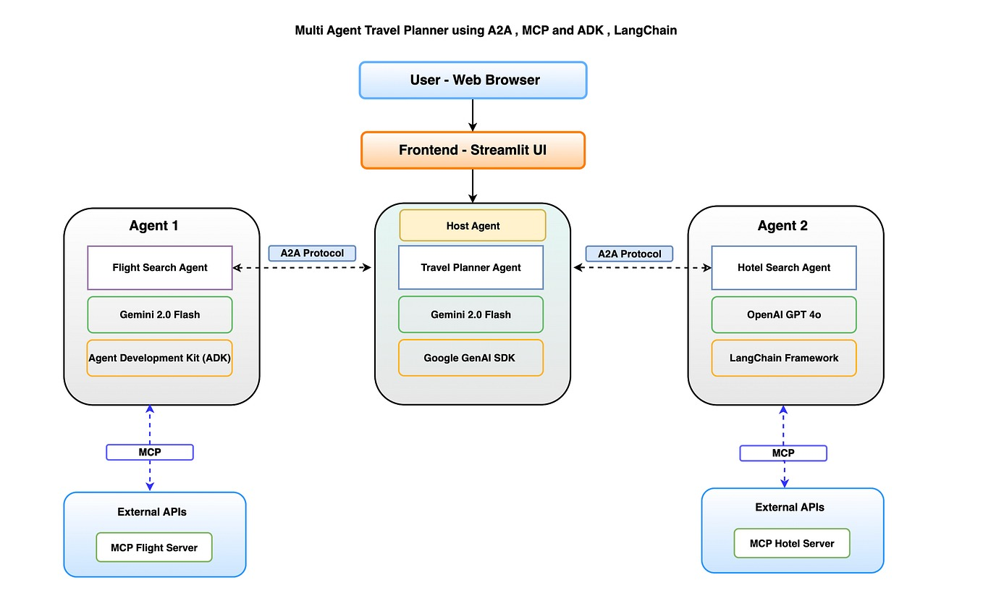
SYSTEM ARCHITECTURE

Slide 7
Module 1 Swarm Coordination and Communication Algorithm
Enables multiple robots to communicate and work together as a swarm.
Robots exchange information such as position, direction, sensor data, and task status.
Uses communication technologies such as Wi-Fi, Bluetooth, or RF modules.
Implements coordination algorithms to decide which robot performs which task.
Robots share local information to improve overall swarm performance.
Includes collision avoidance and coordinated movement.
Basic Working
Sense → Communicate → Decide → Coordinate → Move → Repeat

Slide 8
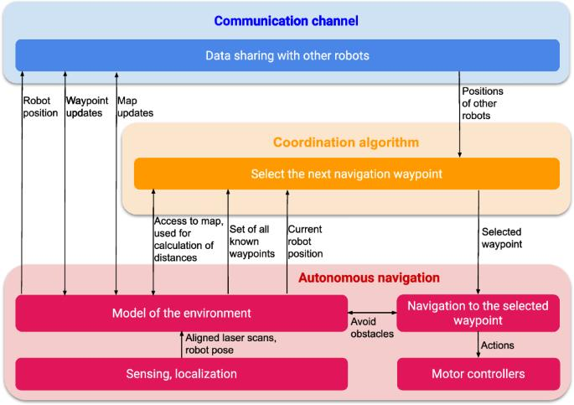
SYSTEM ARCHITECTURE

Slide 9
Module 2 Task Allocation and Collective Goal Achievement
Assigns different tasks to individual robots based on their location, capability, and availability.
The swarm divides a large task into smaller tasks that can be completed simultaneously.
Robots communicate their task status and progress with other agents.
If a robot fails or becomes unavailable, its task can be reassigned to another robot.
Robots coordinate their activities to avoid duplicate work and collisions.
The system continuously monitors task completion and updates the task allocation

Slide 10
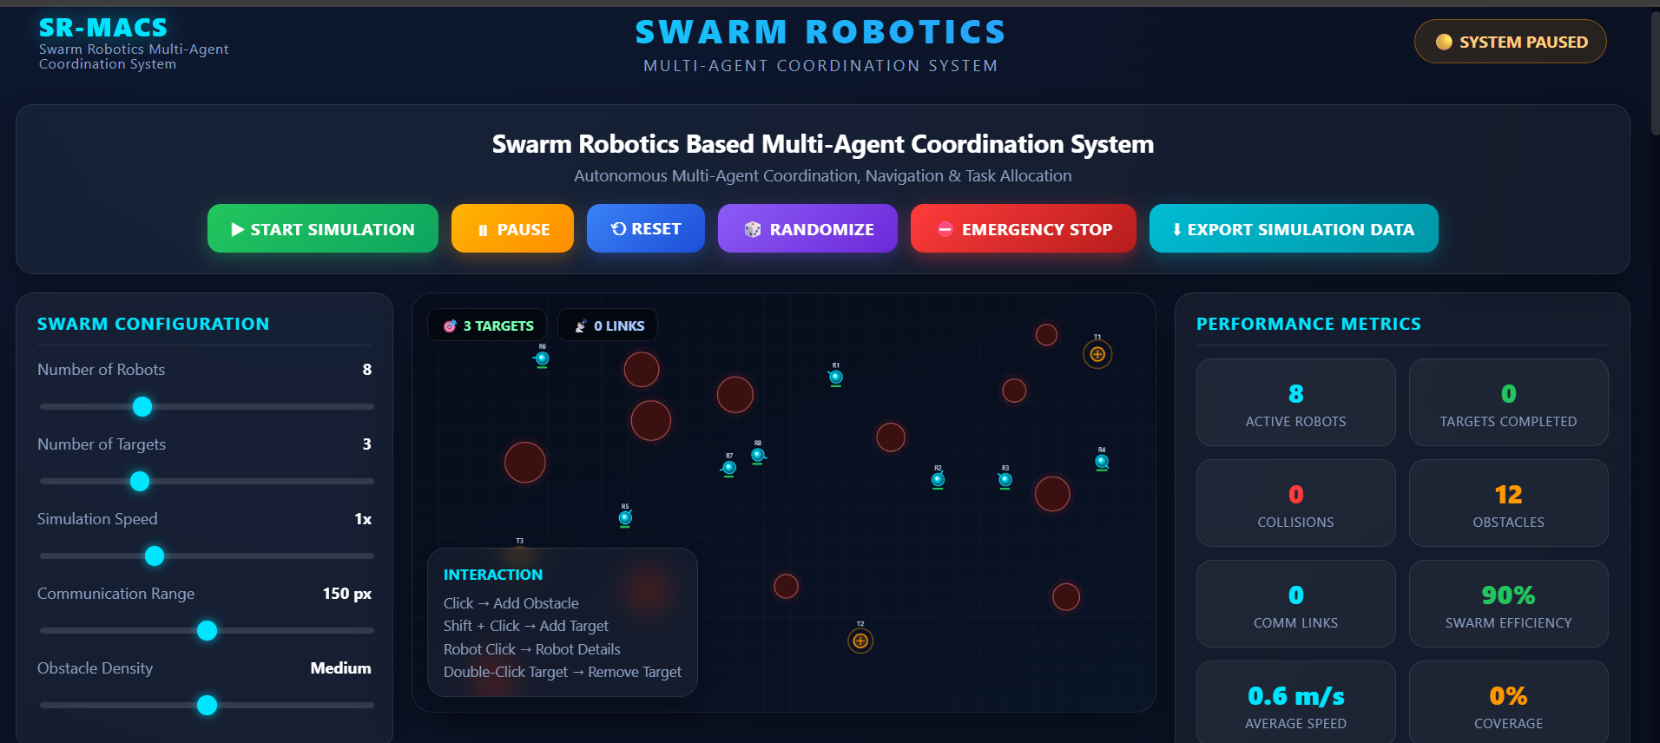
OUTPUT

Slide 11
Results & outcomes
Provided interactive controls including Start, Pause, Reset, Randomize, Emergency Stop, and Export Simulation Data.
Successfully simulated 8 autonomous robots operating in a shared environment.
Enabled multi-agent coordination for movement, navigation, and task execution.
Supported detection and navigation around 12 obstacles.
Managed 3 target locations for cooperative task completion.
Monitored important metrics such as active robots, completed targets, collisions, communication links, speed, and coverage.
Achieved efficient decentralized coordination with reduced collision risk.

Slide 12
CHALLENGES & LIMITATIONS
Challenges:
Communication: Reliable communication between multiple robots can be difficult.
Coordination: Maintaining cooperation among many robots is complex.
Collision Avoidance: Robots must avoid collisions with other robots and obstacles.
Limitations:
Limited processing and sensing capabilities of individual robots.
Dependence on wireless communication can cause delays and data loss.
AI-based coordination may require large training datasets and computational resources.

Slide 13
CONCLUSION
Nables multiple robots to work cooperatively toward a common goal.
Uses decentralized control for independent decision-making.
Improves scalability and flexibility as the number of robots increases.
Provides effective task allocation among multiple agents.
Supports collision avoidance and safe navigation.
Enables formation control and coordinated movement.

Slide 14
REFERENCES
Dorigo, M., Birattari, M., Blum, C., et al. (2023). Swarm Intelligence and Swarm Robotics: Recent Advances and Applications. Swarm Intelligence.
Brambilla, M., Ferrante, E., Birattari, M., & Dorigo, M. (2023). Swarm Robotics: Distributed Coordination and Collective Behavior. Swarm Intelligence.
Bayındır, L. (2023). A Review of Swarm Robotics Research and Multi-Robot Coordination Techniques. Robotics and Autonomous Systems.
O'Bryne, J., & colleagues. (2024). Multi-Agent Coordination and Distributed Control in Swarm Robotics. IEEE Access.
Dorigo, M., Theraulaz, G., & Trianni, V. (2024). Swarm Robotics: Current Challenges and Future Directions. Proceedings of the IEEE.

Slide 15
Thank You!

